Slide 1
SUPPLEMENT SALES ANALYTICS DASHBOARD
Name: Riya AM
Email: riyashafi51@gmail.com
Tool Used: Microsoft Excel
Dataset Source: Supplement Sales Dataset(kaggle)

Slide 2
INTRODUCTION
Problem Statement
Dataset Overview
Data Understanding
Data Cleaning & Preparation
Dashboard
Key Insights & Findings
Challenges Faced
Limitations and Future Enhancement
Tools & Technologies Used
Conclusion

Slide 3
PROBLEM STATEMENT
Understand platform-wise performance
Evaluate impact of discounts on sales
Build a professional Excel dashboard
Identify top-performing product categories

Slide 4
DATASET OVERVIEW
Dataset contains supplement sales information.
Key Features:
    Product Name
    Category
    Revenue
    Units Sold
    Discount
    Platform
    Country
    Date

Slide 5
DATA UNDERSTANDING
Products are divided into categories
Sales vary across platforms and countries
Discounts affect customer purchasing
Time (date) helps analyze trends
Units sold indicates product demand

Slide 6
DATA CLEANING & PREPARATION
Removed duplicate and blank values
Formatted date and numeric columns
Converted dataset into Excel Table
Created calculated columns:
                Revenue After Discount
                Month
                Year
Created KPI metrics:
                Total Revenue
                Total Units Sold
                Average Discount
                Highest Revenue Category

Slide 7
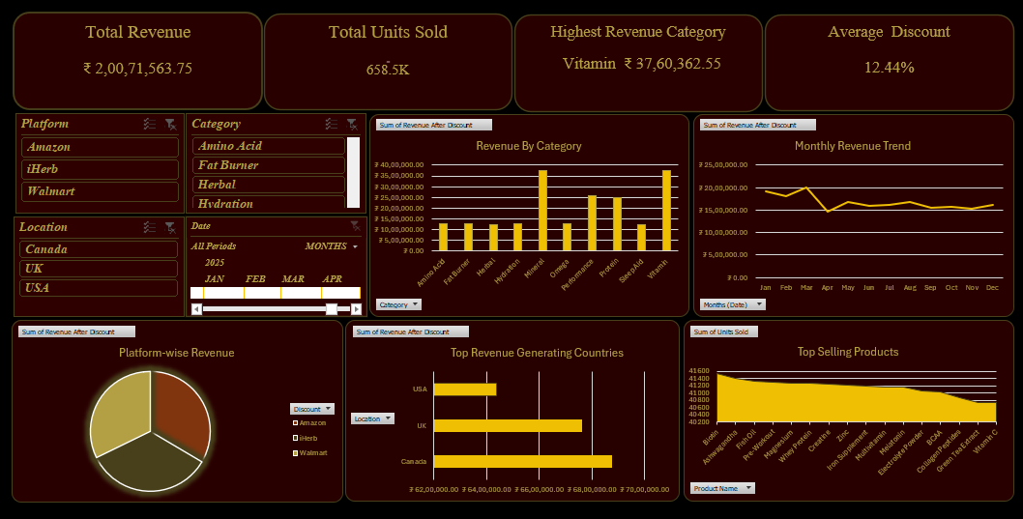

Slide 8
KEY INSIGHTS & FINDINGS
Vitamin category generated highest revenue
Some platforms performed better than others
Discounts influenced sales volume
Certain categories contributed more to total revenue

Slide 9
Challenges Faced
Data cleaning and formatting
Designing dashboard layout
Aligning charts and KPI cards
Connecting slicers to all visuals

Slide 10
Future Improvements
Add profit analysis
Create sales forecasting
Use advanced Excel features
Improve dashboard design

Slide 11
Tools Used
Microsoft Excel
Pivot Tables
Pivot Charts
Slicers

Slide 12
Conclusion
Helps analyze sales performance effectively
Interactive filters improve user experience
Excel is a powerful tool for data analysis

Slide 13
THANK YOU

